Slide 1
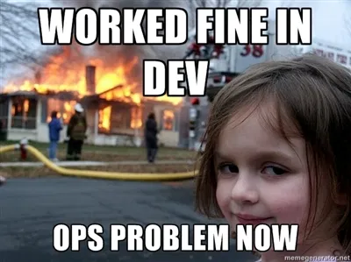

Slide 2

“Warning”
Lecture is very short (as in… 10 minutes)
Use remaining time for help with assignments!

Slide 3
Deployment
What is it?
“Production”

Slide 4
Deployment
Making your application available for your users
URL
IP-address
Downloadable app in Play Store / App Store
Burning a CD
…

Slide 5
Deployment for Laravel
Make app available on internet
Give it a URL

Slide 6
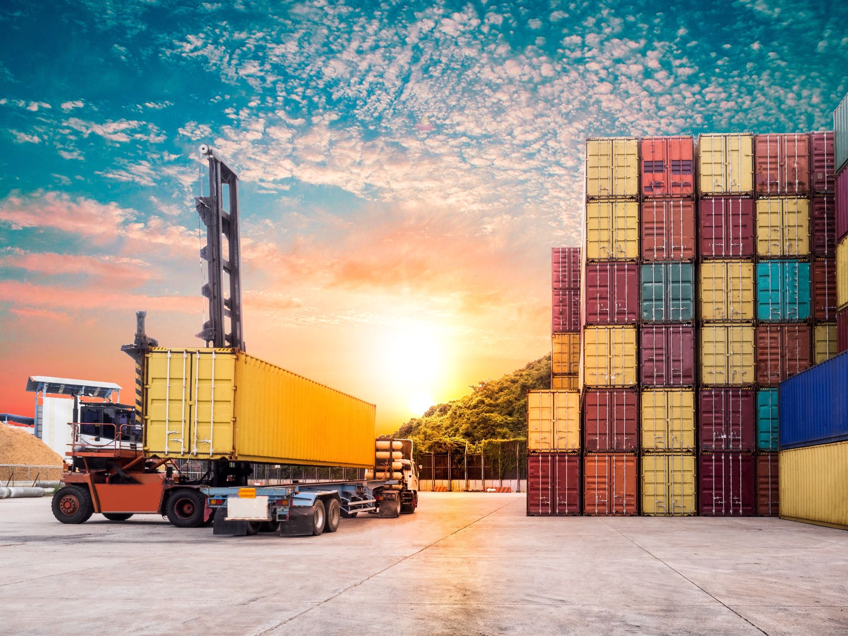
Use Docker?
You can deploy using Docker
Never ever deploy containers that you run in Development envs
Always create dedicated production containers

Slide 7

Recommended deployment
Don’t use Docker for deployments (yet)
For most, this is your first “real” deployment
Docker is finnicky with security when you don’t really know what you’re doing.
You are probably creating a security hole the size of Gargantua if you deploy using Docker
Notes:
Ter referentie: Gargantua = 100 miljoen keer onze zon. Dat stipje middenop de slide is een planeet ter grootte van Jupiter

Slide 8
Recommended deployment
Just deploy using systemwide Php, Apache/Nginx and MySQL
Don’t forget your .env file!
APP_ENV
DEBUG_MODE
…

Slide 9

Not convinced?
https://www.laradocker.com/
Reverse proxies, stateless volume management, manual HTTPS configuration, …
Oh and this guy forgot file permission issues
But you got this ;)

Slide 10
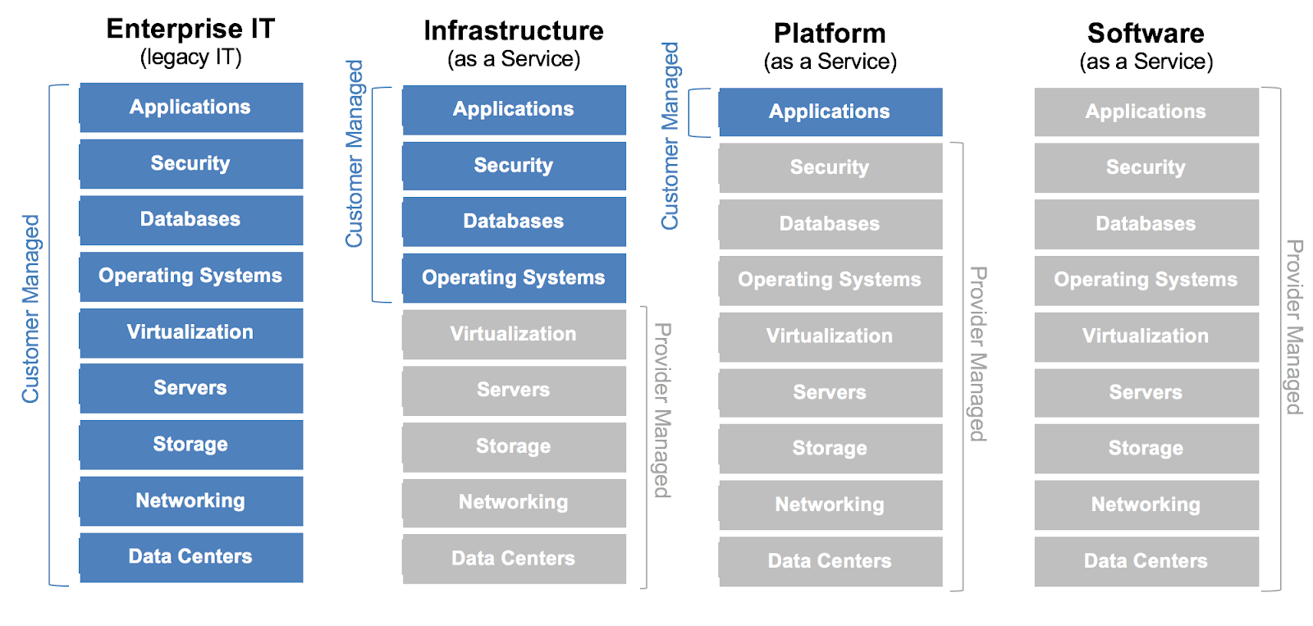

Slide 11





Slide 12
GitHub Student pack
Free credits to Heroku, DigitalOcean and Azure
Heroku + DigitalOcean → if you have credit card
Azure → Keep +/- €75 in credits for Year 2!!!
No credit card? Use a cheap hosting provider such as Strato: https://www.strato.nl/hosting/hosting-mini/
Server for €1 per month + domain name. Beer is more expensive!
After DevOps, repurpose it to host your portfolio/resume ?
https://education.github.com/pack

Slide 13
Requirements
There needs to be a database
The database can be manipulated via the web app (CRUD)
I need to log in
So provide me with credentials
Or make sure registering new accounts works
All HTTP traffic needs to be encrypted with TLS → HTTPS

Slide 14
Sources
Heroku & Laravel: https://devcenter.heroku.com/articles/getting-started-with-laravel
DigitalOcean LAMP stack (assignment 1): https://www.digitalocean.com/community/tutorials/how-to-install-linux-apache-mysql-php-lamp-stack-on-ubuntu-22-04
Forcing Laravel apps to use HTTPS in production: https://stackoverflow.com/questions/35827062/how-to-force-laravel-project-to-use-https-for-all-routes
Forcing web servers to use HTTPS in production: https://riptutorial.com/apache/example/7807/force-https

Slide 15
Questions for DevOps?
Feel free to ask them!
You only have 2 weeks left.
An assignment takes about 2 days
Make sure you schedule enough time for both project and IT Development Portfolio!

